Slide 1
The Nature of WAVES
Ballou 2016
Mr. Meyers
Unit II (Energy)

Slide 2
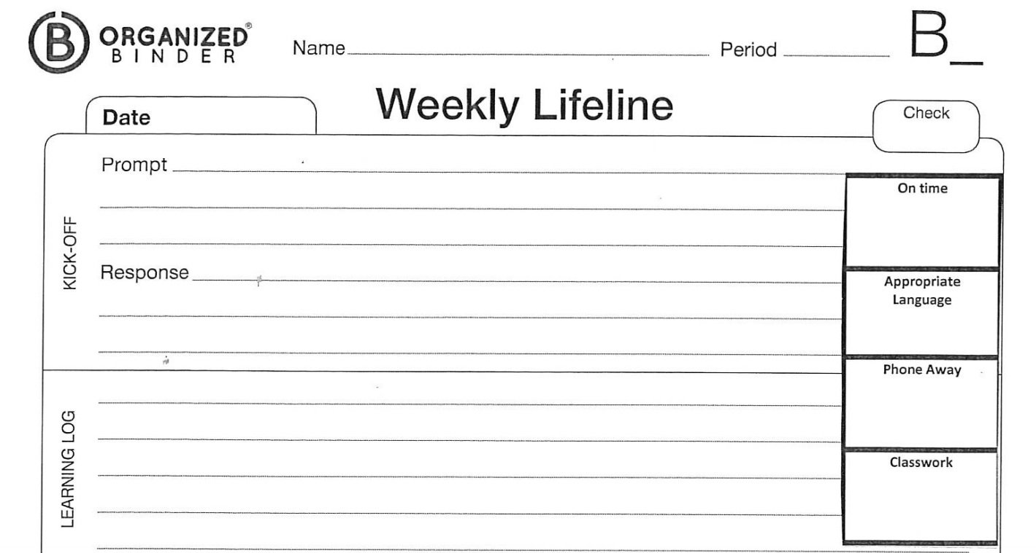
Kick-Off
Complete sentences
~ 5-7 min
Mr. Meyers
A1, A4, A5
3.1
1/23/2017
1. Describe your idea of a wave? Where have you seen or heard about waves? Provide an example.
2. Identify waves in our classroom (Remember not all waves travel in water). How do waves transmit energy.
TIER 2: Provide an example of one of the three Laws of Motion. Be sure to state which law is being highlighted.

Slide 3
Turn, Talk, Share, & Write
~ 3 min
When I say START, pass your lifeline to your nearest neighbor
For 45 seconds each student will edit their partner’s responses to the lifeline.
Write 1 glow and 1 grow from their response
+ = At least three complete sentences, few to no grammar errors
= A minimum of two complete sentences some grammar errors
- = Does not complete lifeline on time, sentences incomplete
The person that WOKE UP the EARLIEST will SHARE the SUGGESTIONS and EDITS on their partner’s LIFELINE, FIRST.
Students will be RANDOMLY called to SHARE OUT what THEIR PARTNER discussed. BE PREPARED TO SHARE!!

Slide 4
Agenda
~ 1 min
In Class:
Lifeline
Turn, Talk, & Write
Objective
Organized Binder Check
Cornell Notes
What is wave energy?
Types of waves
Independent Reading
Chapter 20 section 1
Round Robin Activity
Learning Log
Homework:
Complete “The Nature of Waves” Chp 20:1 (G3.1)

Slide 5
Announcements
PHONES ARE AWAY!!!
Due TODAY
Binder Check – Everyone should have a binder
Quiz 3.1 due 1/22/2017
STAY FOCUSED so we can meet our OBJECTIVE

Slide 6
Objective
~ 2 min
By the end of class students will describe and define a wave and how it transmits energy by deconstructing informational text and illustrating the properties of a wave.
Standard: HS-PS4-1. Use mathematical representations to support a claim regarding relationships among the frequency, wavelength, and speed of waves traveling in various media.
Developing Skills:
Synthesize information independently and constructively
Develop critical thinking skills through inquiry driven activities.

Slide 7
Group Activity
~ 2 min
When I say START, you and members of your assigned group will DEMONSTRATE and DEFINE what a wave is.
For 2 minutes each group will develop strategize as to how to create a wave. Once completed ALL groups members will write down the definition of a wave without any resources.
Rules:
Every group member must contribute
No cellphones
2 minute timer
A group definition MUST be written down before the time runs out
Reward:
1st place 100 hero points, 5pts extra credit on quiz
2nd place 75 hero points
3rd place 50 hero points
4th place 25 hero points

Slide 8
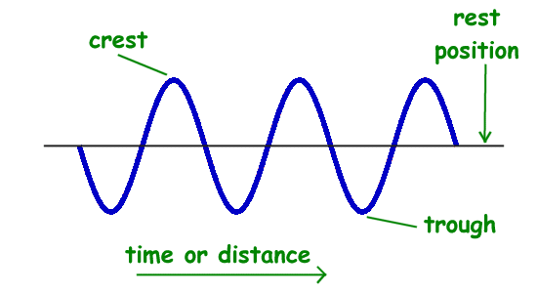
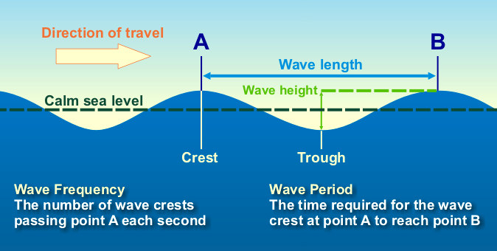
What is a wave?
~ 2 min
A wave is any disturbance that transmits energy through matter or empty space.
A wave travels through a material or substances called a medium. A medium may be a solid, liquid, or a gas.
As a wave travels, it does work on everything in its path. The waves traveling through a pond do work on the water.

Slide 9
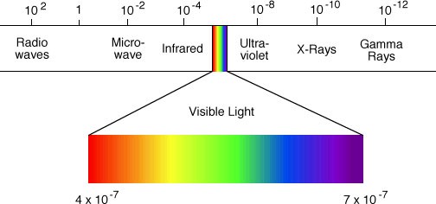
Waves and Mediums
~ 3 min
Waves transfer energy through a medium
When a particle vibrates, it can pass its energy to the particle next to it. In this way, energy is transmitted through a medium.
Waves that require a medium are called mechanical waves. (Ex: sound waves, ocean waves, and earthquake waves).
Waves transfer energy without a medium
Waves that transfer energy without a medium are called electromagnetic waves. (Ex: visible light, microwaves, TV and radio signals, and X-rays).
Electromagnetic waves may also go through matter, such air, water or glass.

Slide 10
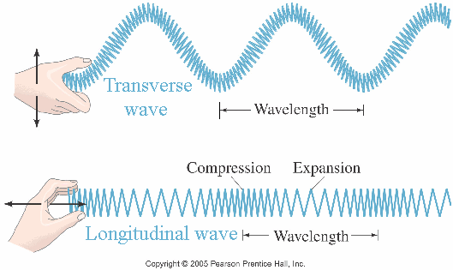
Types of waves
~ 2 min
Transverse Wave – A moving wave that consists of oscillations occurring perpendicular to the directions of energy transfer
Longitudinal Wave – Waves in which the displacement of the medium is in the same direction, or the opposite direction to the wave.

Slide 11
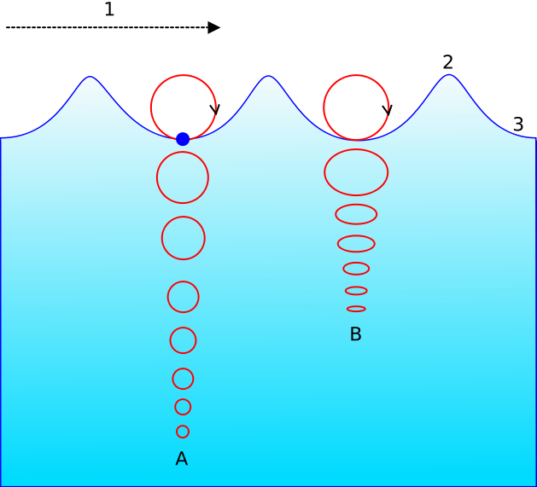
Types of waves
Surface Wave – Waves that travel in both transverse and longitudinal motion. A particle in a surface wave will appear to move in a circular motion.
These types of waves are typically found in the ocean.

Slide 12
Independent Practice (15-20 min)
Option 1:
Complete your GOLD Sheet for in your Organized Binder for Advisory III.
Be sure to use COMPLETE SENTENCES
Must have at least 3 sentences for each section
Option 2:
Read Chapter 20:1 The Nature of Waves.
Answer all side questions and review questions on a separate sheet of paper.
Submit answers by 1/25/2017

Slide 13
Group Activity (Round Robin)
~ 1 min
When I say START, you and members of your assigned group will DEMONSTRATE your COMPREHENSION from the text by answering questions.
Each group will have 1 minute to answer the question and support their answers using a text. It is important to JUSTIFY each answer.
We will use round-robin style for calling on groups, if a group does not completely answer the question, another group will get a chance to steal their points.
Rules:
Every group member must contribute
No cellphones
1 minute timer
All answers must be written down before the timer goes off
Reward:
1st place 100 hero points, 5pts extra credit on quiz
2nd place 75 hero points
3rd place 50 hero points
4th place 25 hero points

Slide 14
Group Activity (Round Robin)
Question 1:
Draw a transverse wave and label all its parts?

Slide 15
Group Activity (Round Robin)
Question 2:
What is the difference between a transverse wave and longitudinal wave?

Slide 16
Group Activity (Round Robin)
Question 3:
What is a wave and describe how a wave performs work?

Slide 17
Group Activity (Round Robin)
Question 4:
What is the difference between a mechanical wave and electromagnetic wave?

Slide 18
Group Activity (Round Robin)
Question 5:
Name three examples of mechanical waves.

Slide 19
Group Activity (Round Robin)
Question 6:
Name four examples of electromagnetic waves.

Slide 20
Learning Log
(5 min)
Mr. Meyers
A1, A4, A5
3.1
1/23/2016
1. Did we meet our objective? How was it achieved, if not achieved explain why? How has your idea of what a wave is, changed? What questions do you still have?

